Slide 1
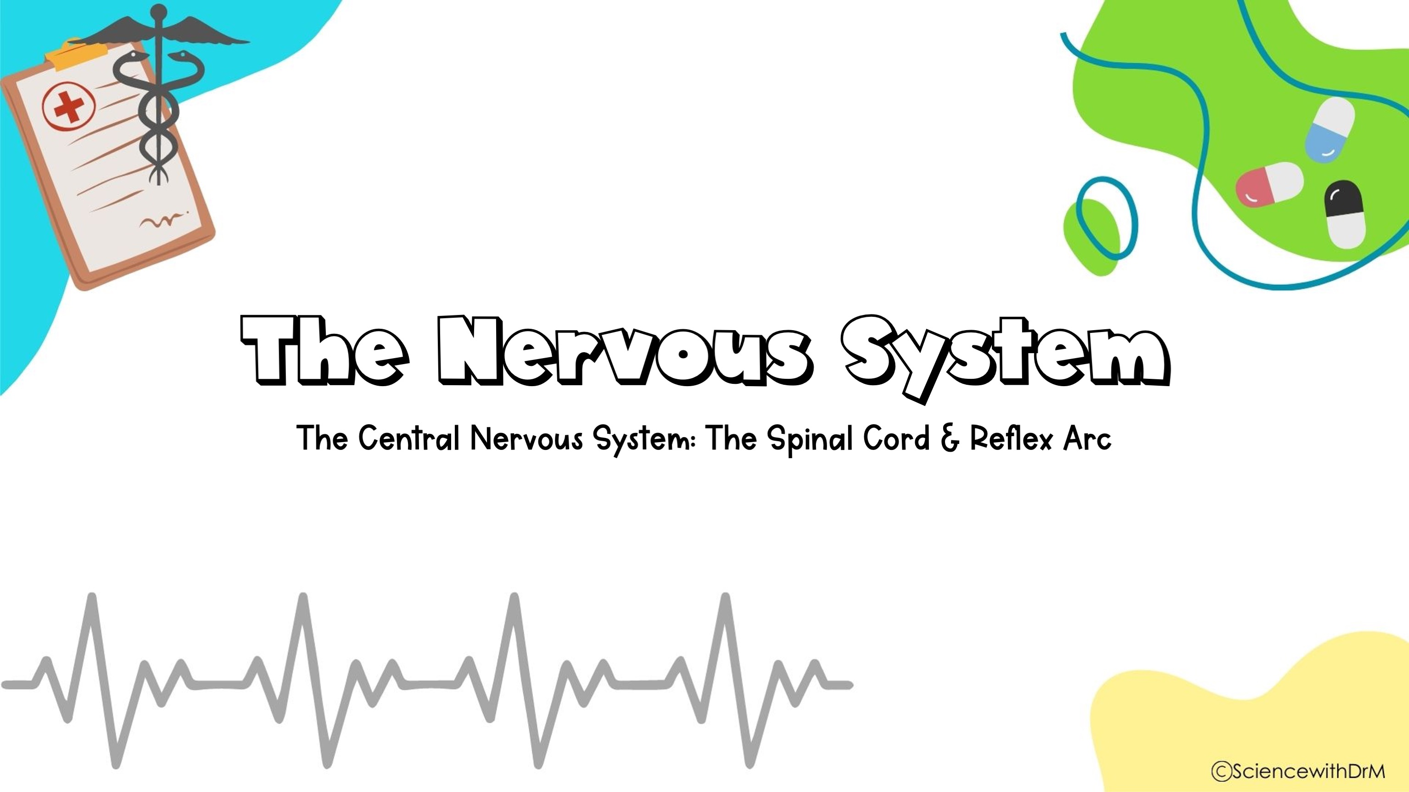
Quizlet Link: https://quizlet.com/_904ait?x=1jqt&i=lcu99

Slide 2
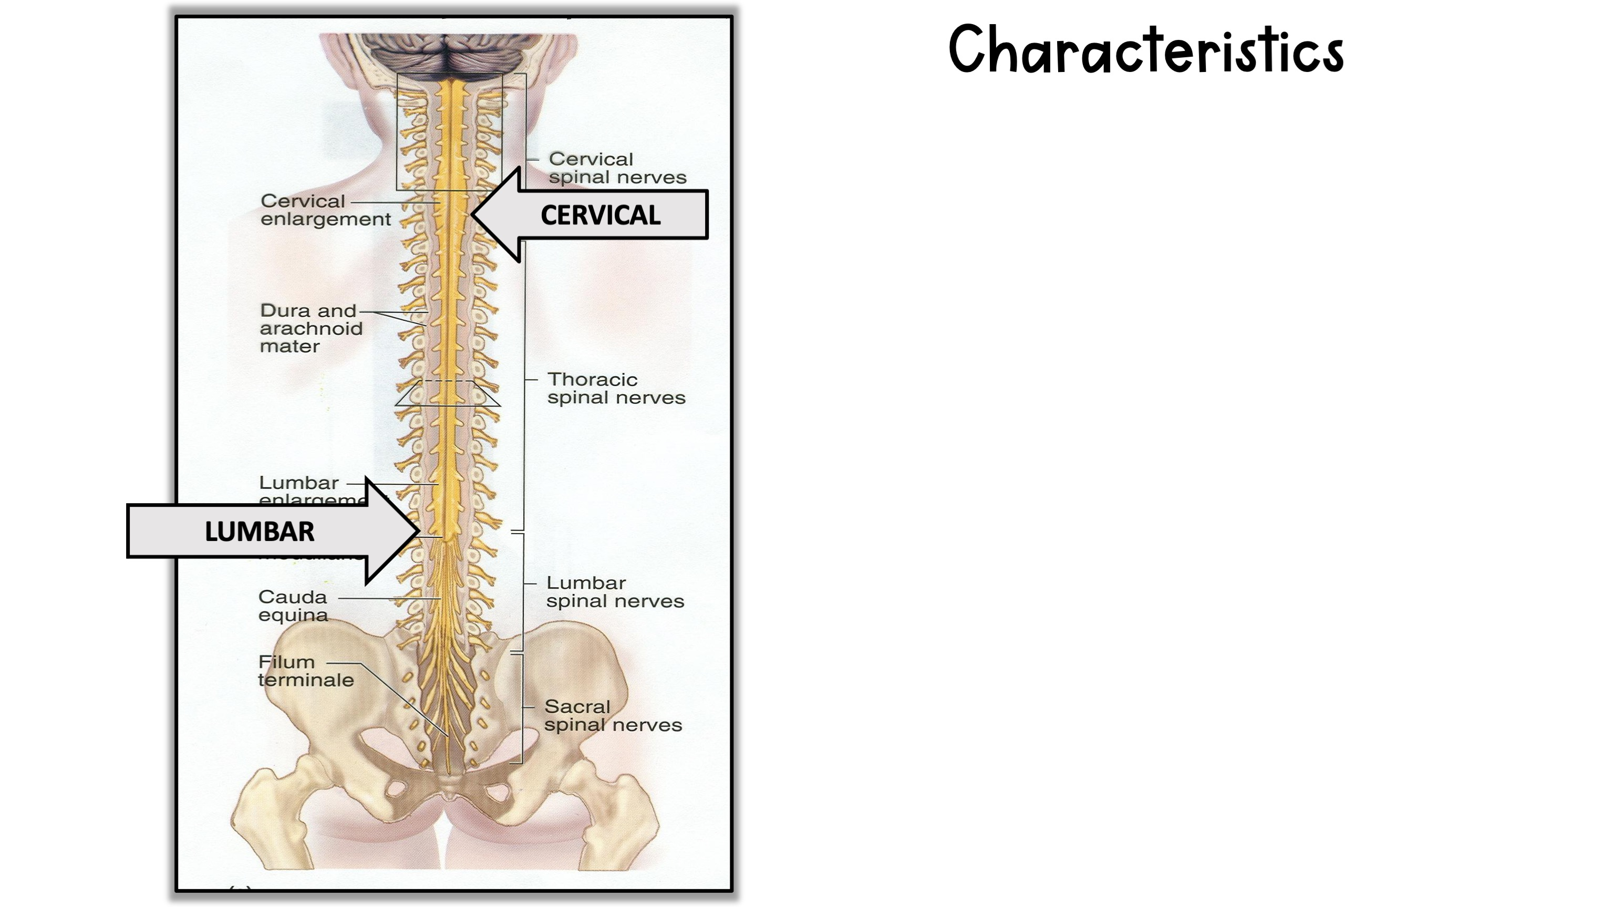
1. Diameter- 1.8 cm (3/4 in) thick
2. Length- 42cm (17in) long. Extends from Foramen Magnum (where it is continuous with the Medulla) to the level of the 1st or 2nd lumbar vertebrae.
3. Enlargements- (2)
A. Cervical- nerves for upper limbs
B. Lumbar- nerves for lower limbs
4. Segments- segmented like spinal column; each segment has 1 pair spinal nerves coming from it.

Slide 3
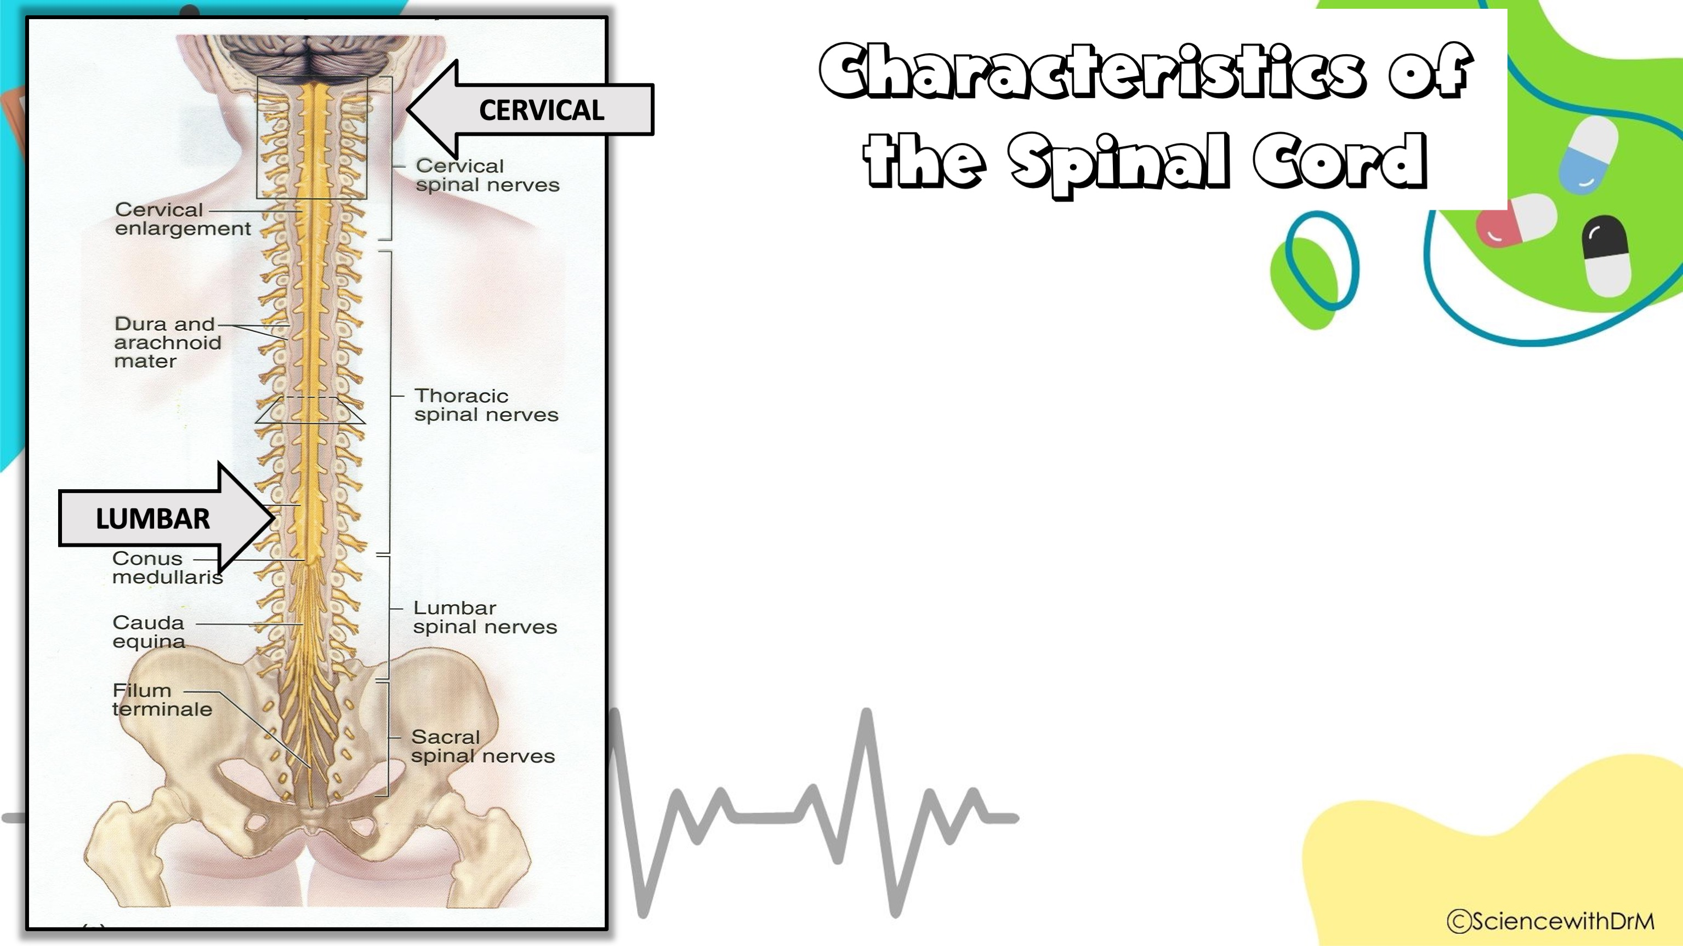
Diameter- 1.8 cm (3/4 in) thick
Length- 42cm (17in) long.
Extends from Foramen Magnum (where it is continuous with the Medulla) to the level of the 1st or 2nd lumbar vertebrae.
3. Enlargements- (2)
A. Cervical- nerves for upper limbs
B. Lumbar- nerves for lower limbs
4. Segments- segmented like spinal column; each segment has 1 pair spinal nerves coming from it.

Slide 4
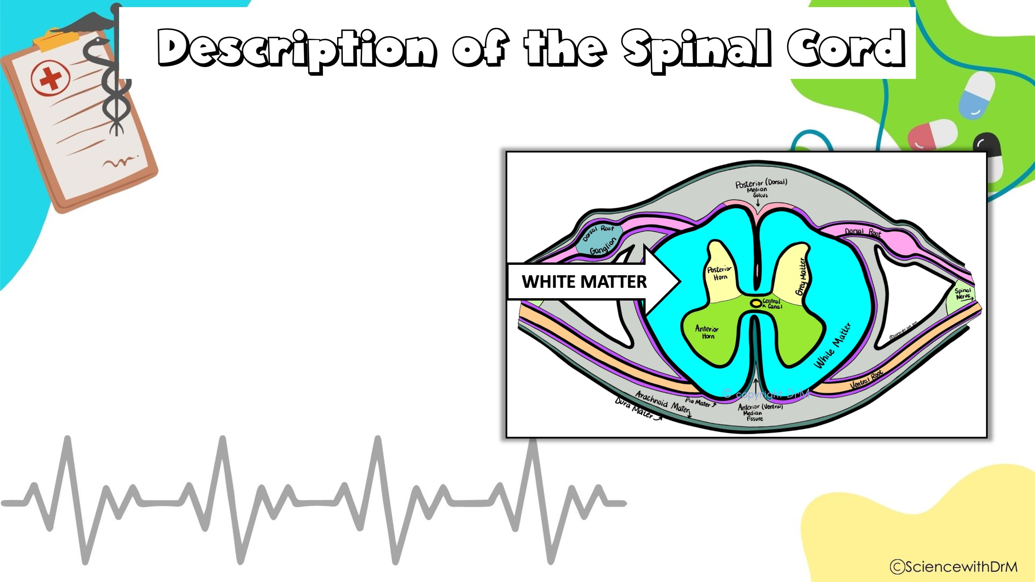
Cylindrical structure composed of white matter (myelinated fiber tracts)

Slide 5

Cylindrical structure composed of white matter (myelinated fiber tracts) surrounded by an H-shaped area of grey matter (unmyelinated neurons).

Slide 6
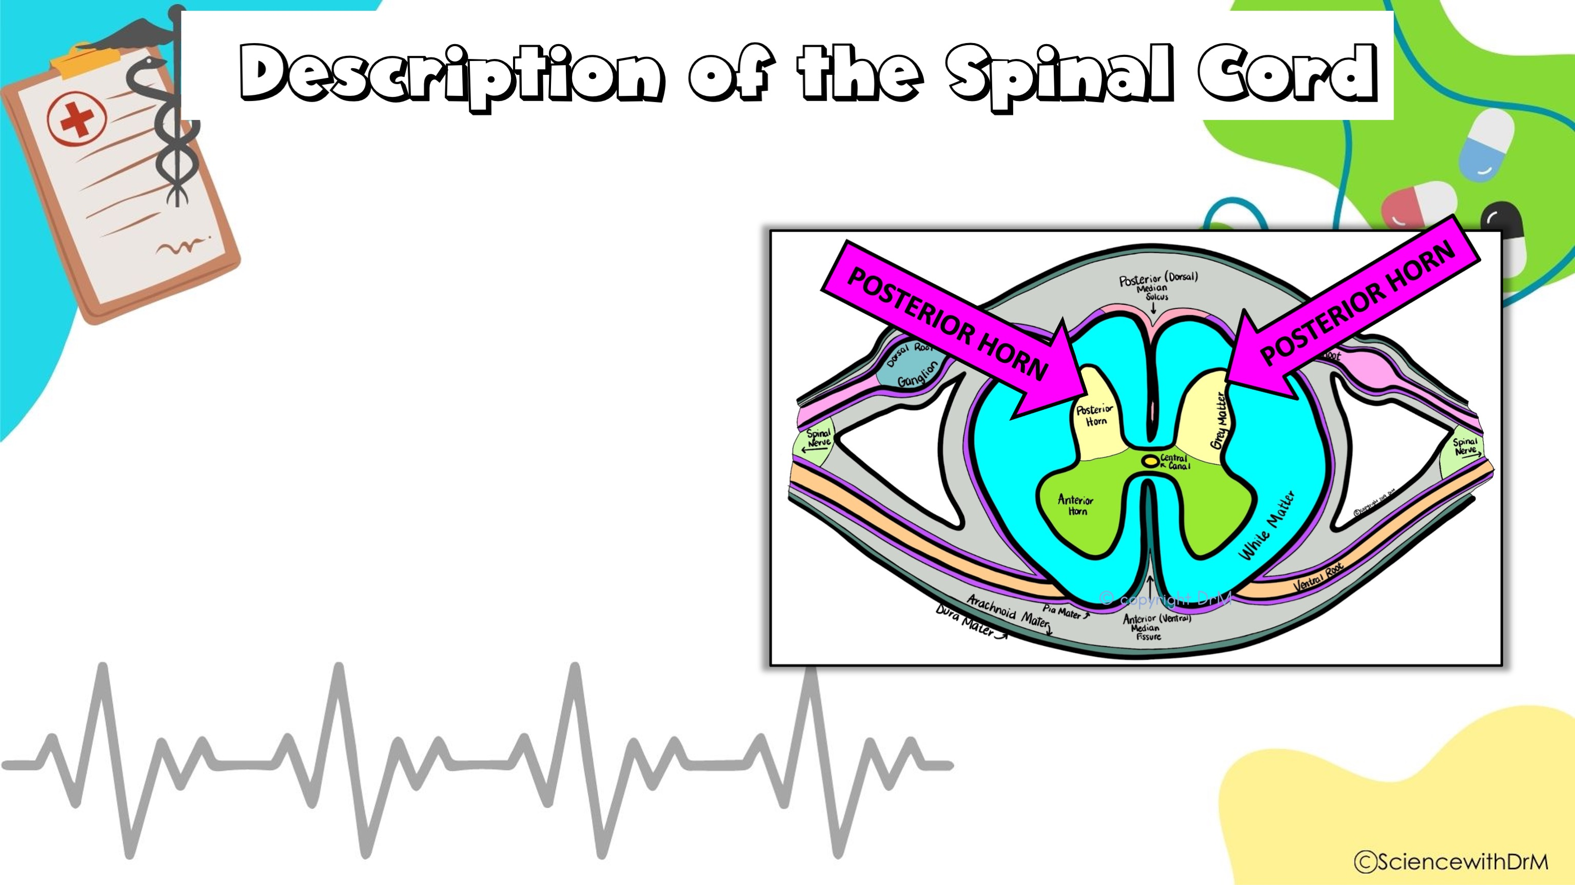
The two posterior projections (called dorsal or posterior horns)

Slide 7
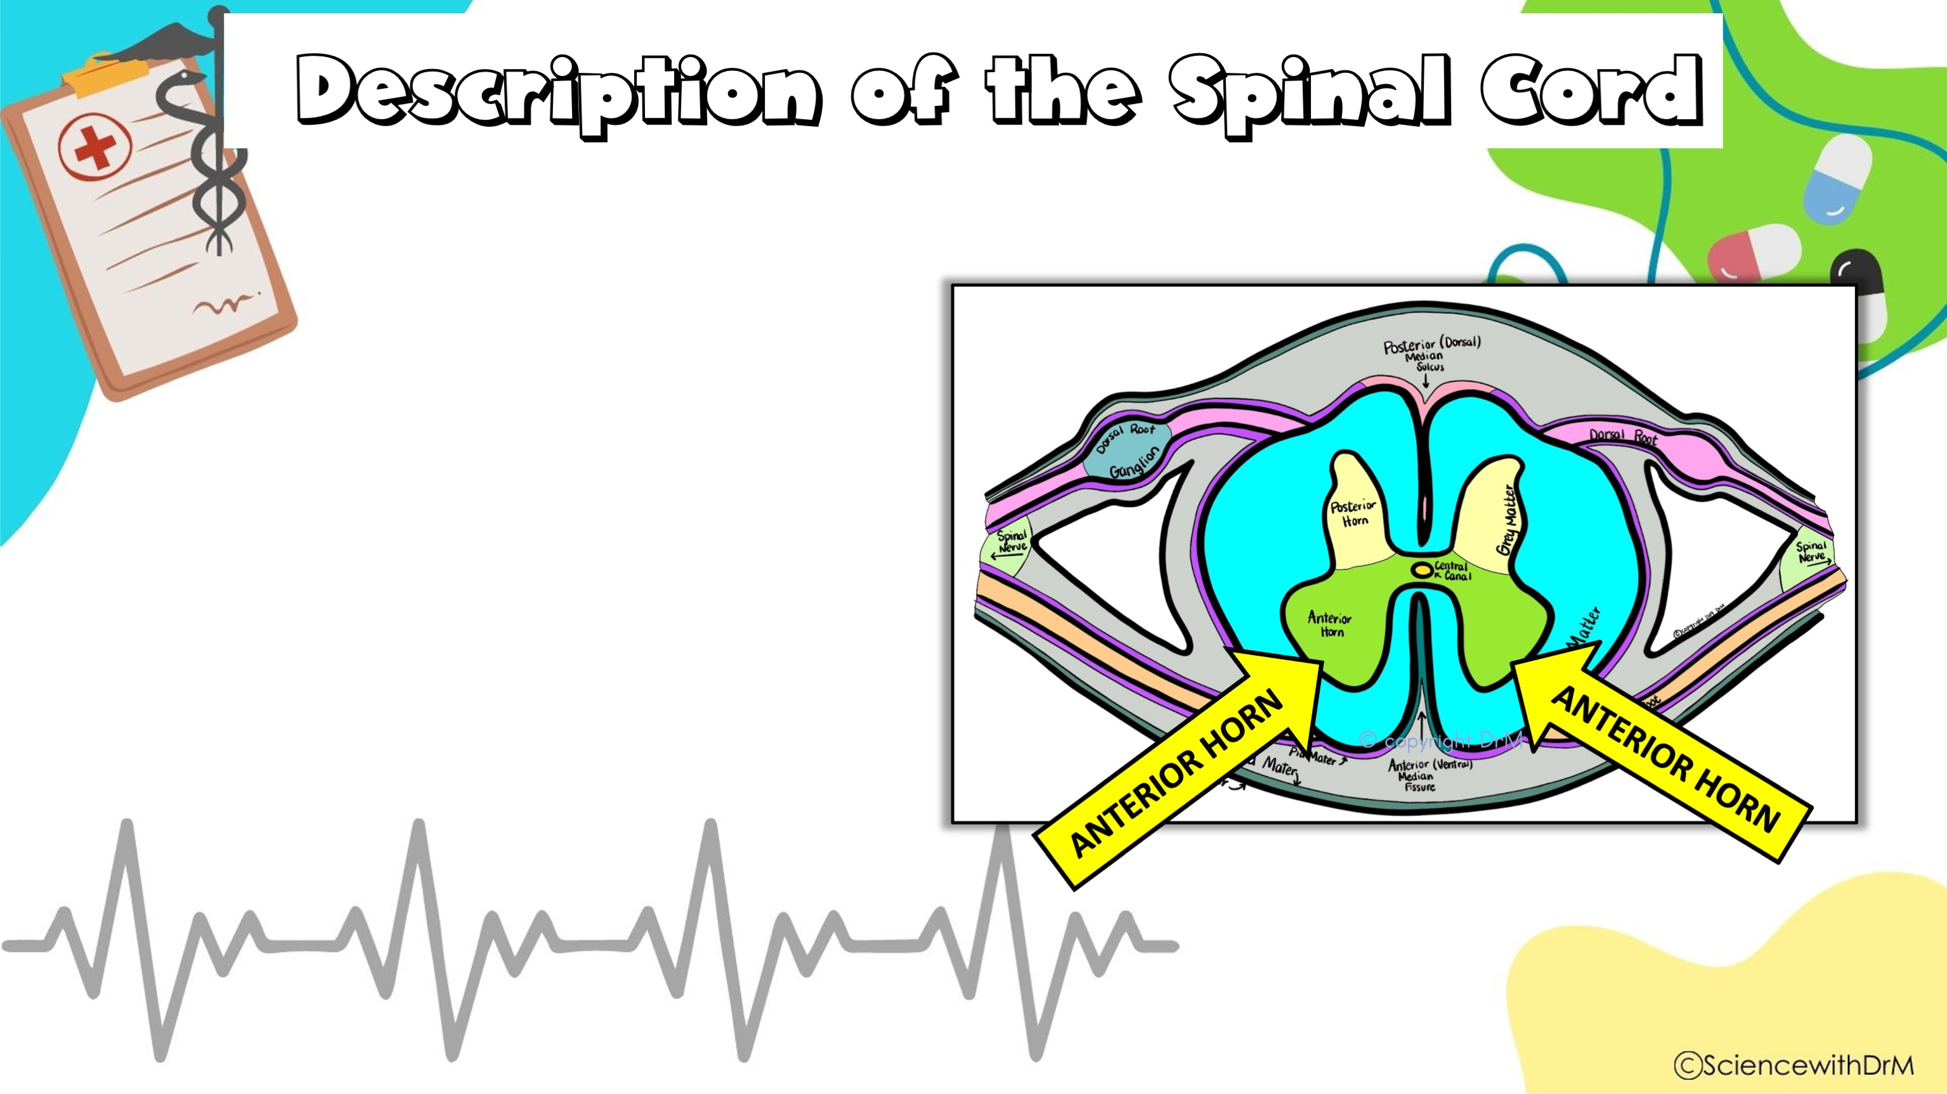
The two posterior projections (called dorsal or posterior horns) and the two anterior projections (called ventral or anterior horns)

Slide 8
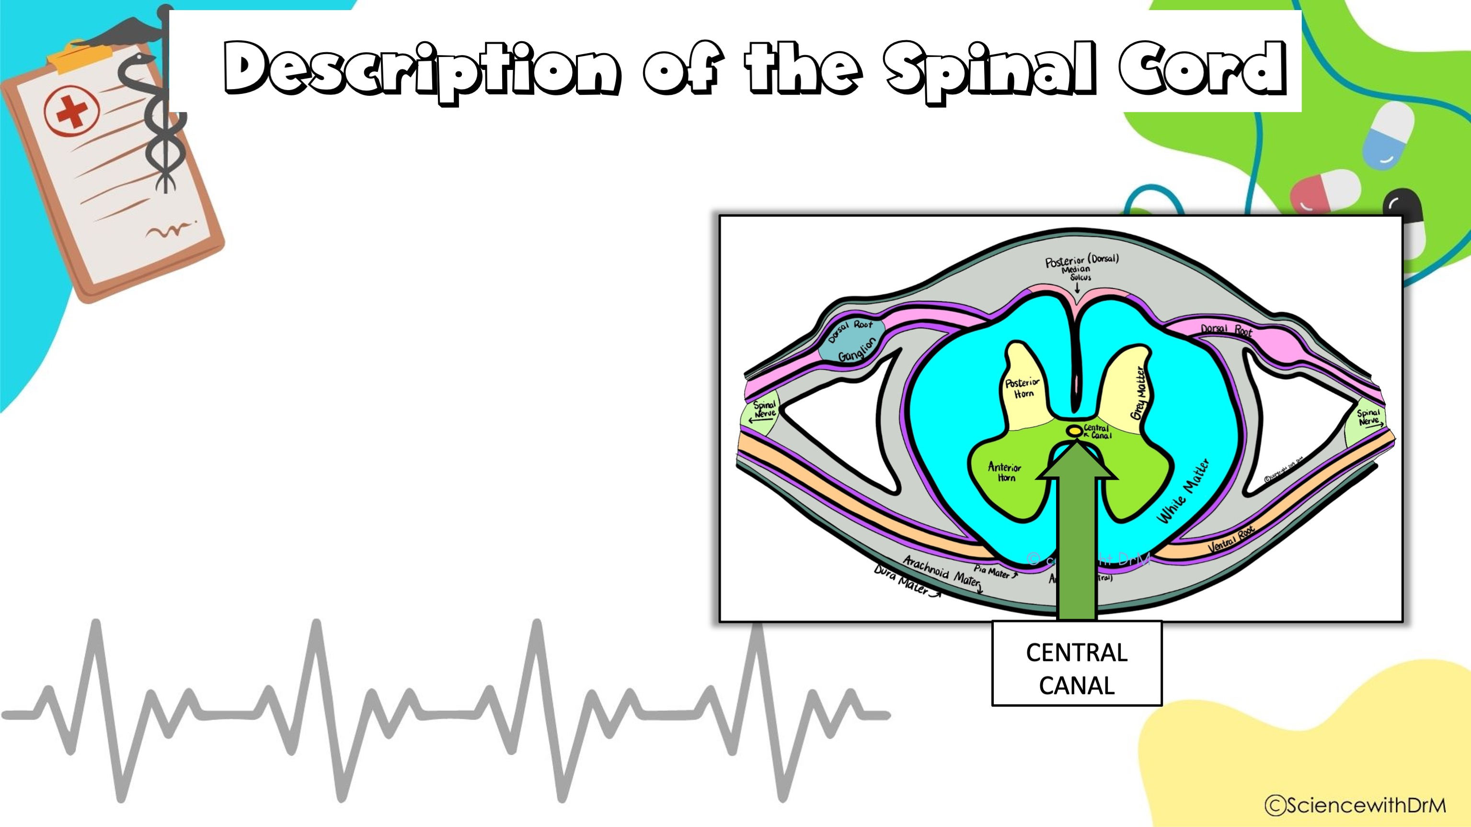
The two posterior projections (called dorsal or posterior horns) and the two anterior projections (called ventral or anterior horns) surround the Central Canal containing Cerebrospinal Fluid (CSF).

Slide 9

The two posterior projections (called dorsal or posterior horns) and the two anterior projections (called ventral or anterior horns) surround the Central Canal containing Cerebrospinal Fluid (CSF).
1. Dorsal (Posterior) horns-contain interneurons

Slide 10
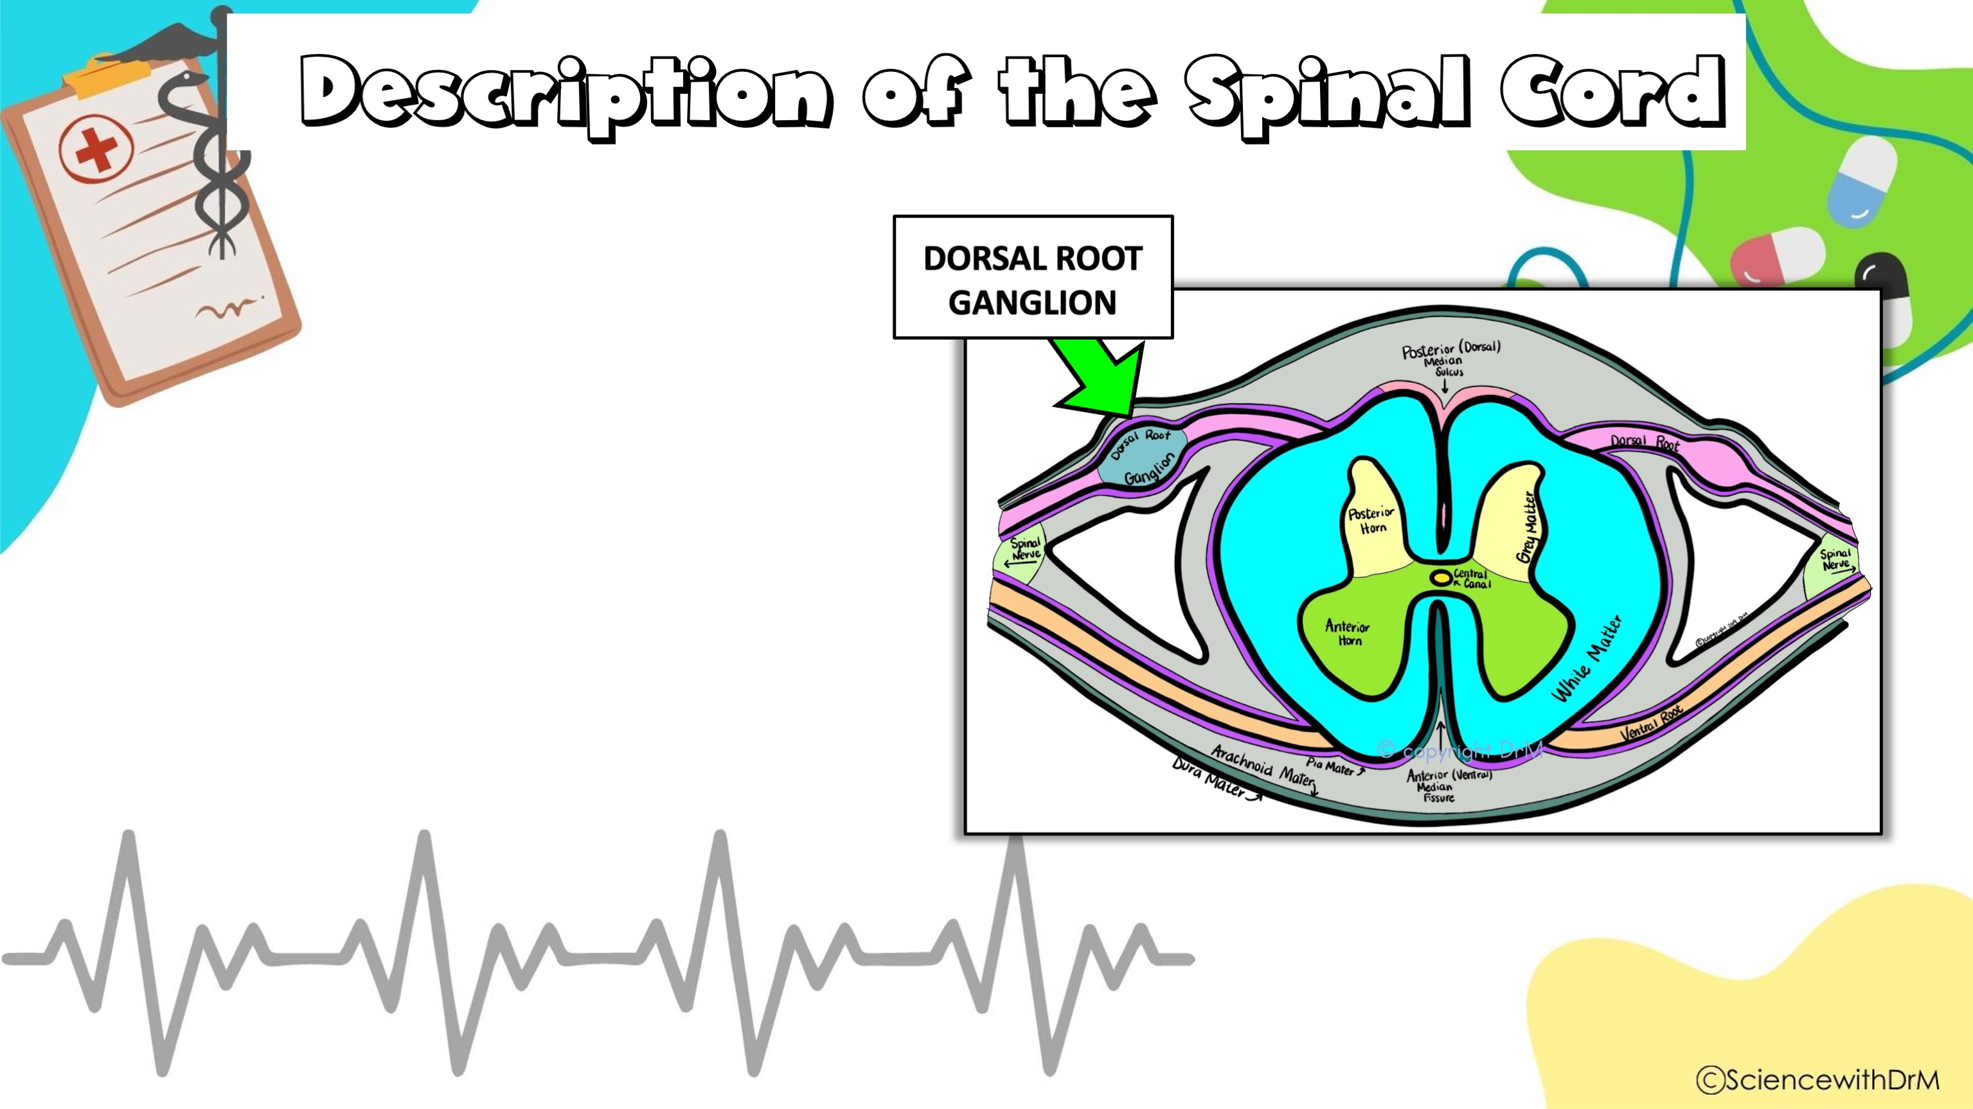
The two posterior projections (called dorsal or posterior horns) and the two anterior projections (called ventral or anterior horns) surround the Central Canal containing Cerebrospinal Fluid (CSF).
1. Dorsal (Posterior) horns-contain interneurons
2. Dorsal root ganglion-enlarged area of dorsal horn that contains cell bodies of sensory neurons.

Slide 11

The two posterior projections (called dorsal or posterior horns) and the two anterior projections (called ventral or anterior horns) surround the Central Canal containing Cerebrospinal Fluid (CSF).
1. Dorsal (Posterior) horns-contain interneurons
2. Dorsal root ganglion-enlarged area of dorsal horn that contains cell bodies of sensory neurons.
3. Ventral (Anterior) horns-contain cell bodies of motor neurons. Axons of these neurons exit the ventral root and fuse to form spinal nerves.

Slide 12
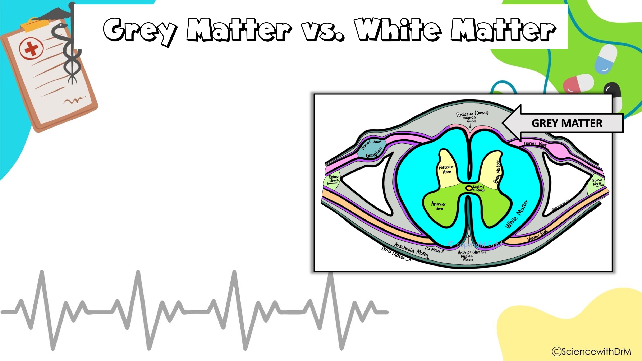
Grey matter is for sensory and motor functions

Slide 13

Grey matter is for sensory and motor functions
White matter is to communicate between parts of the spinal cord and between the spinal cord and the brain

Slide 14
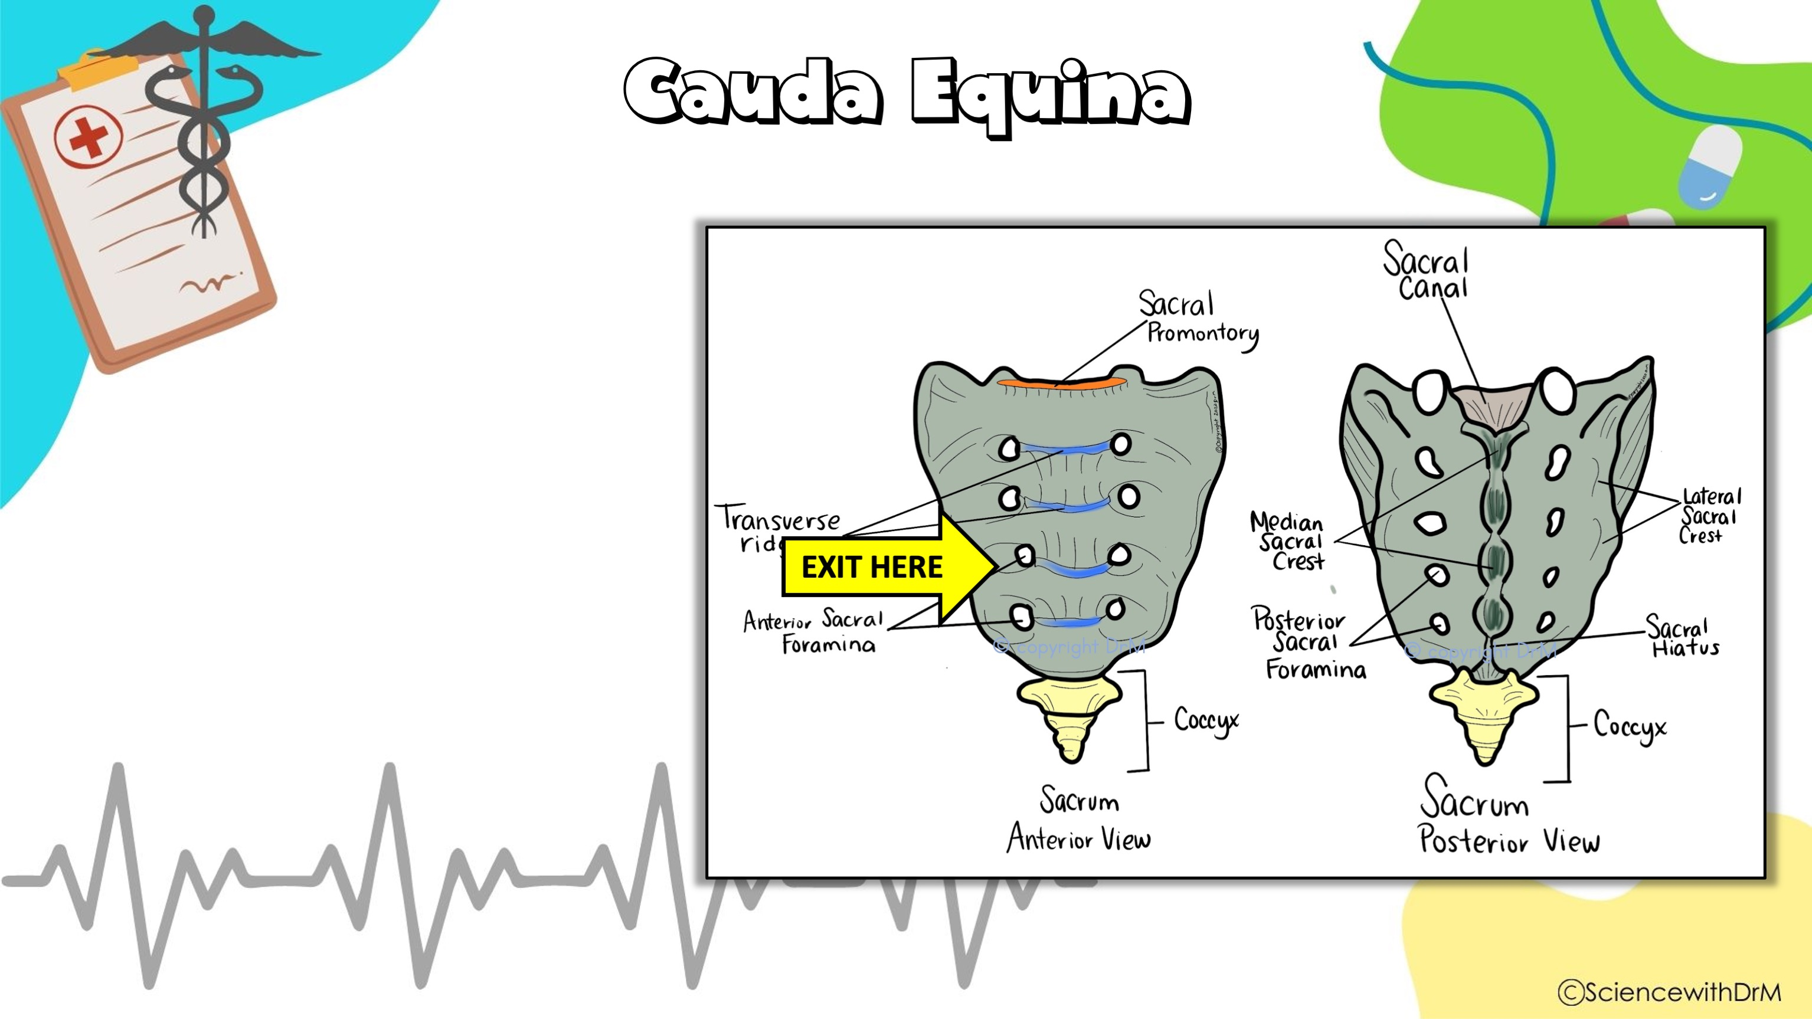
Cauda equina (“horse’s tail”)
end of spinal cord where nerves exit through holes in sacrum.

Slide 15
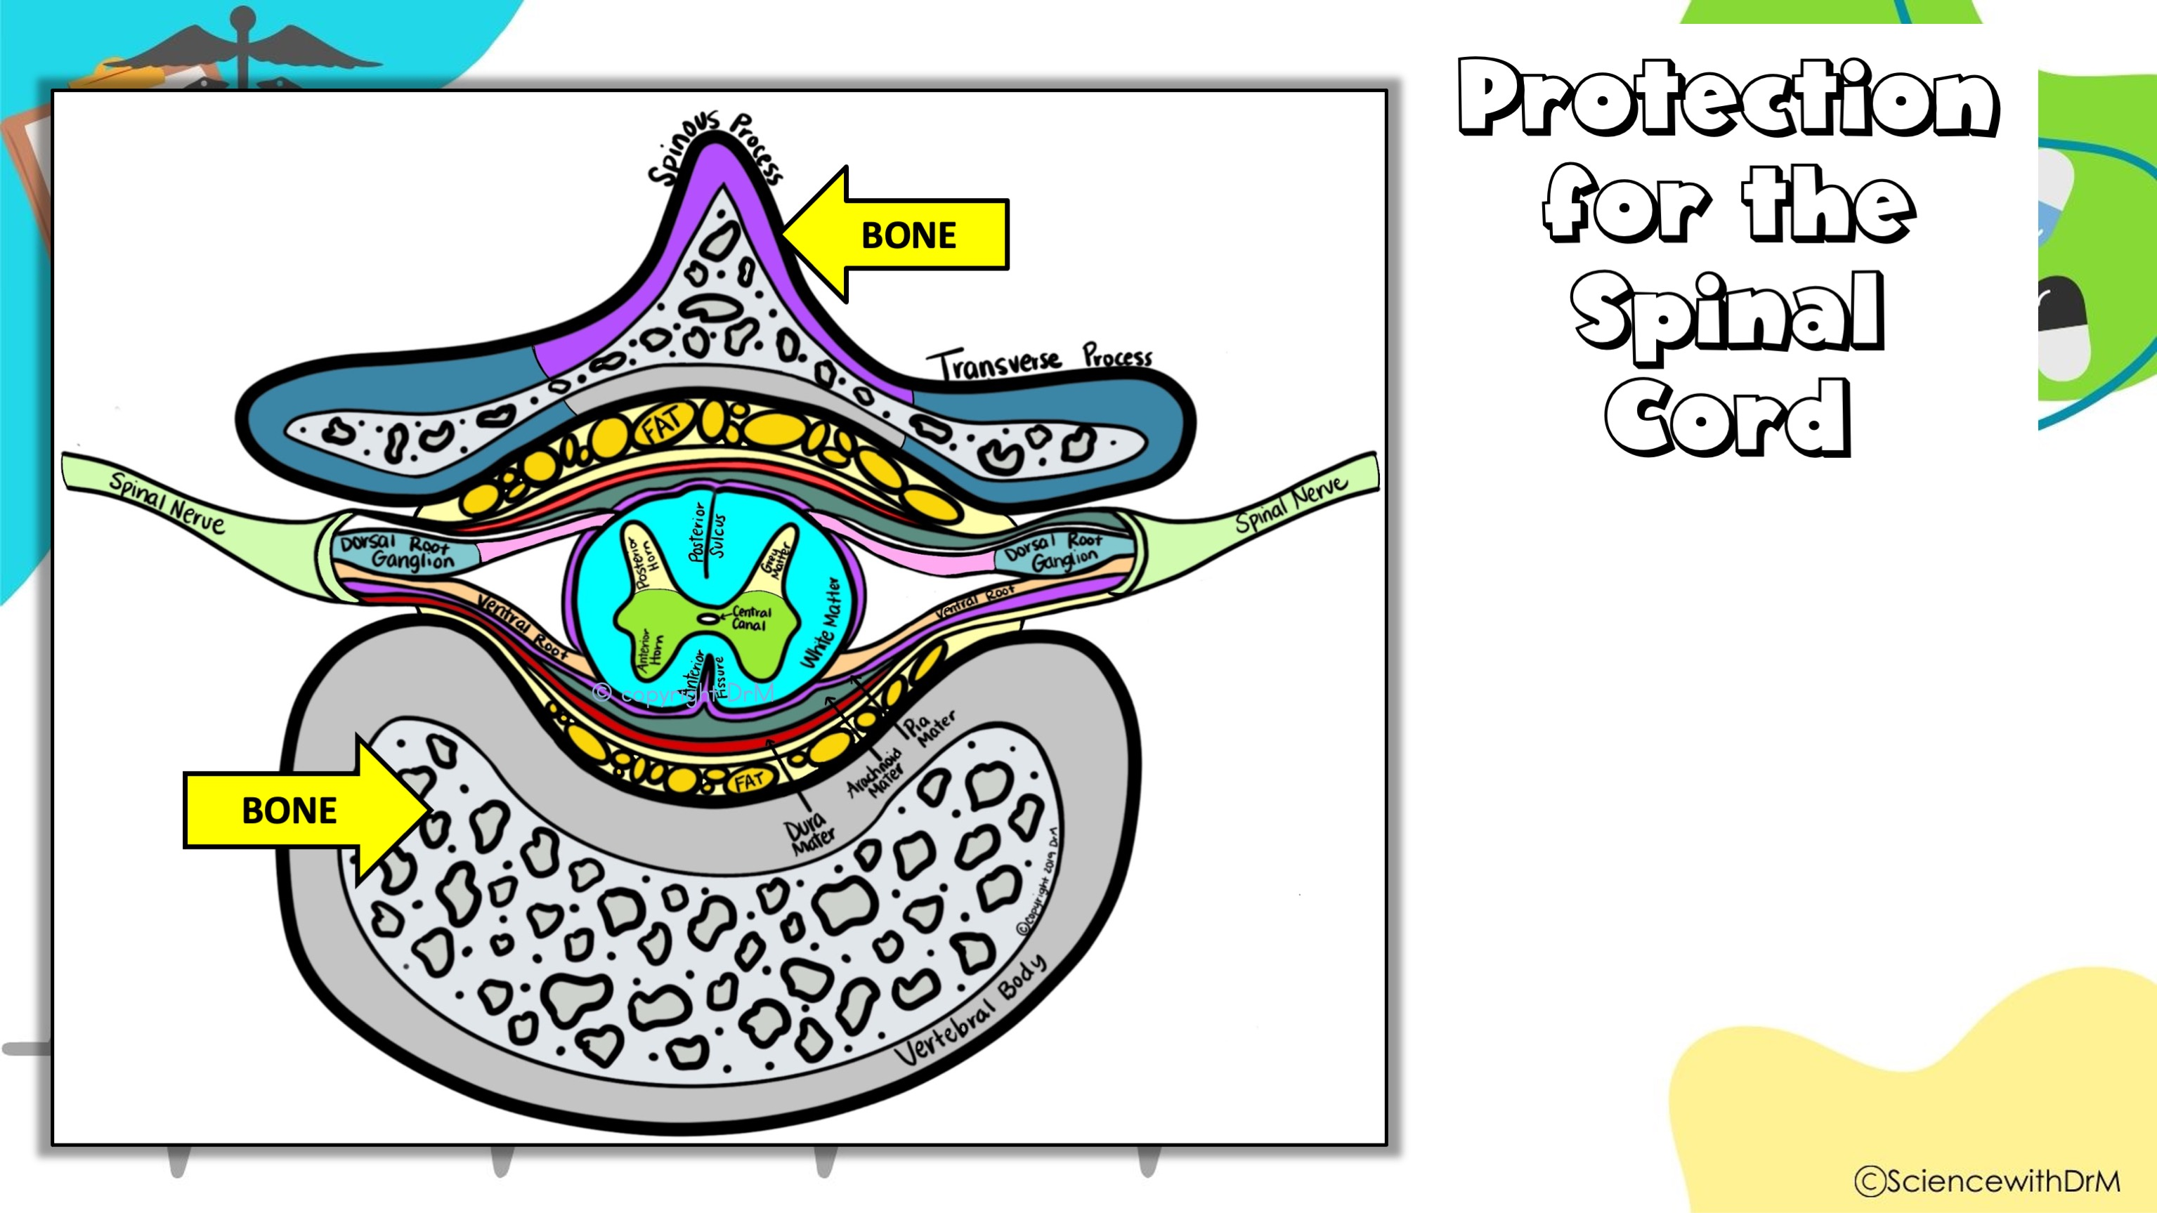
Bone
Vertebrae
Each area of the vertebral column has a different structure.

Slide 16
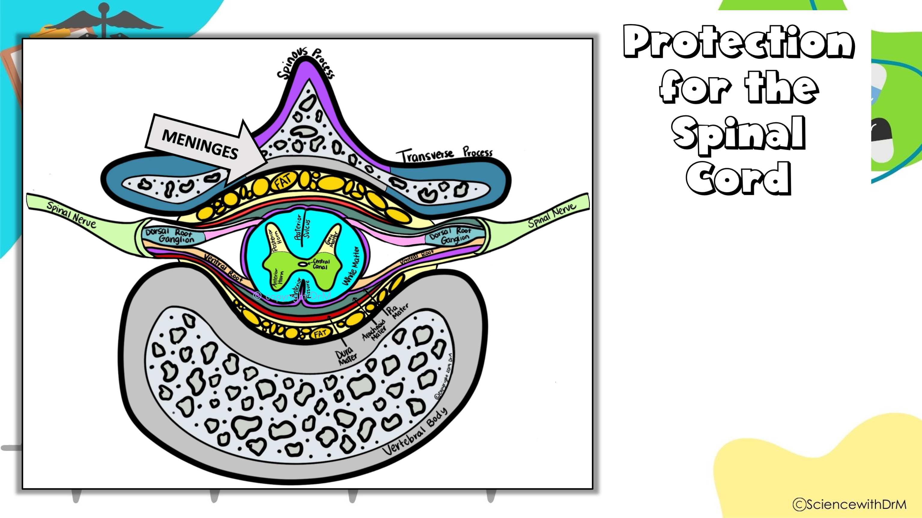
Meninges
Spinal cord has 3 membranes covering it (same as brain)

Slide 17
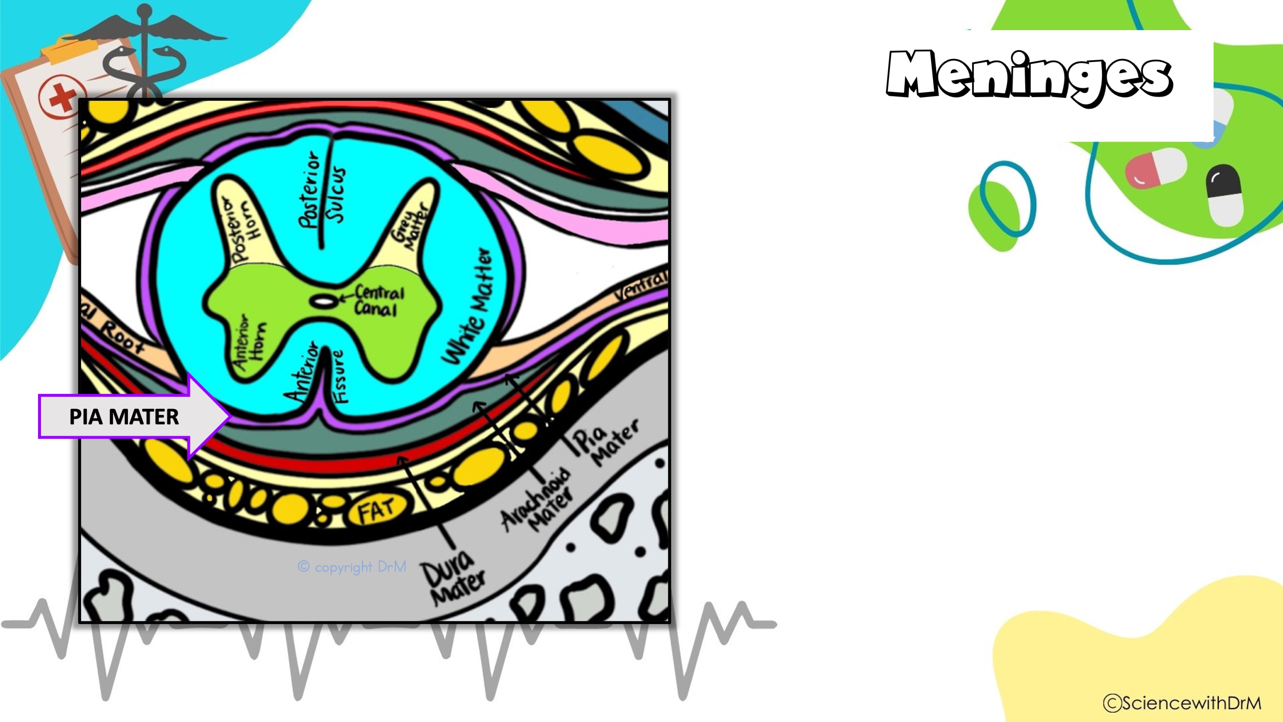
2. Meninges-spinal cord has 3 membranes covering it (same as brain)
a. Pia mater (inner)- very delicate.

Slide 18
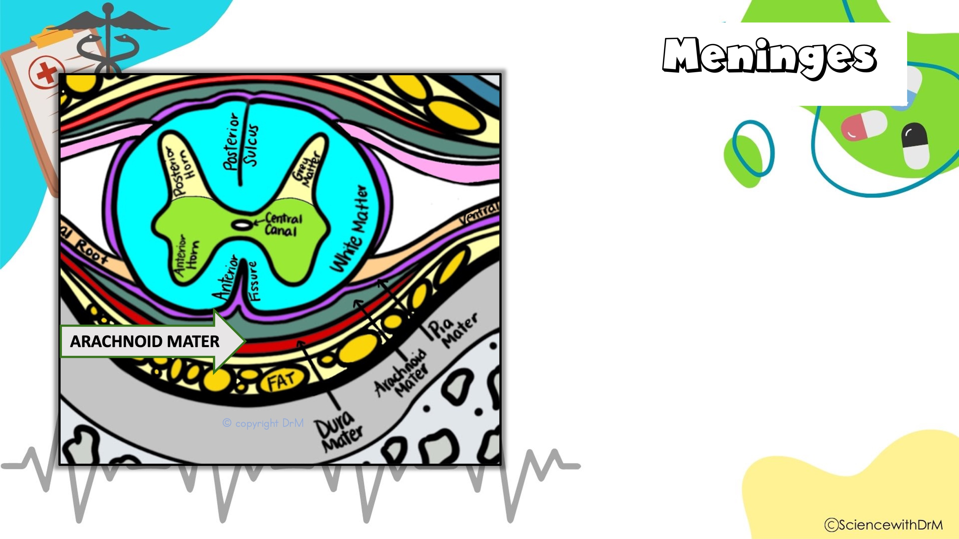
2. Meninges-spinal cord has 3 membranes covering it (same as brain)
a. Pia mater (inner)-delicate.
b. Arachnoid mater (middle)-loose, “spider web-like”.

Slide 19

2. Meninges-spinal cord has 3 membranes covering it (same as brain)
a. Pia mater (inner)-delicate.
b. Arachnoid mater (middle)-loose, “spider web-like”.
c. Dura mater (outer)-tough, leathery, “durable”.
An easy way to remember is that the meninges PAD the spinal cord/brain Pia; Arachnoid; Dura Mater

Slide 20
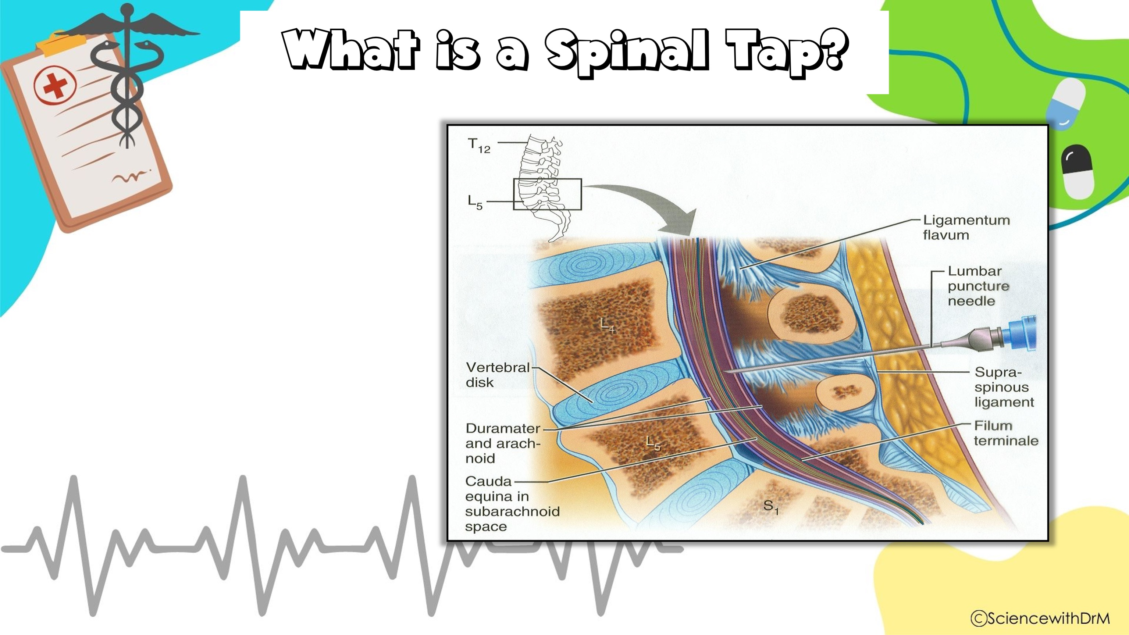
A spinal tap (lumbar puncture) is when CSF is drawn out for examination
It is done around L3 (3rd lumbar vertebrae) because that area is past the length of the spinal cord.

Slide 21
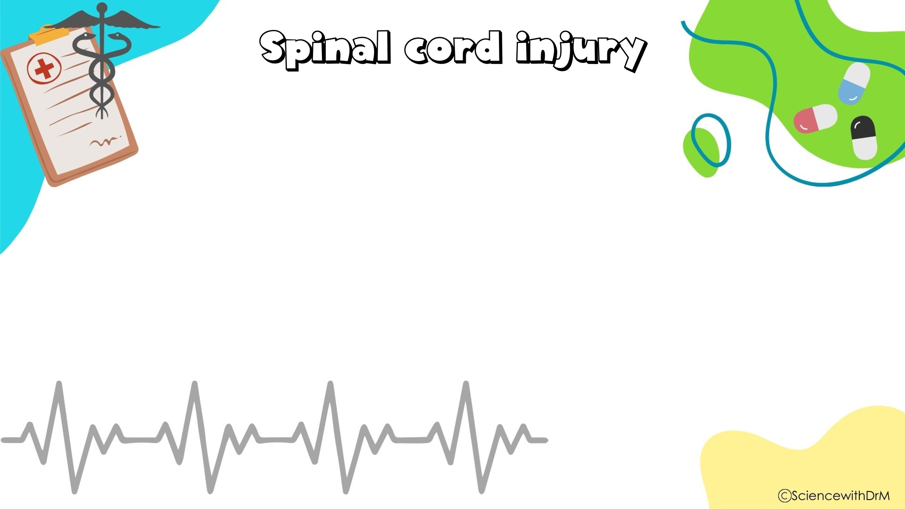
Effect of the injury depends upon the location that the spinal cord was damaged.
Types of injuries:
Flaccid paralysis- damage to anterior horn; causes muscles to atrophy
Spastic paralysis- cut or crushed cord; causes irregular nerve impulses
Paraplegia- cut between T1- L1; affects lower limbs only
Quadriplegia- damage in cervical region; all 4 limbs affected

Slide 22
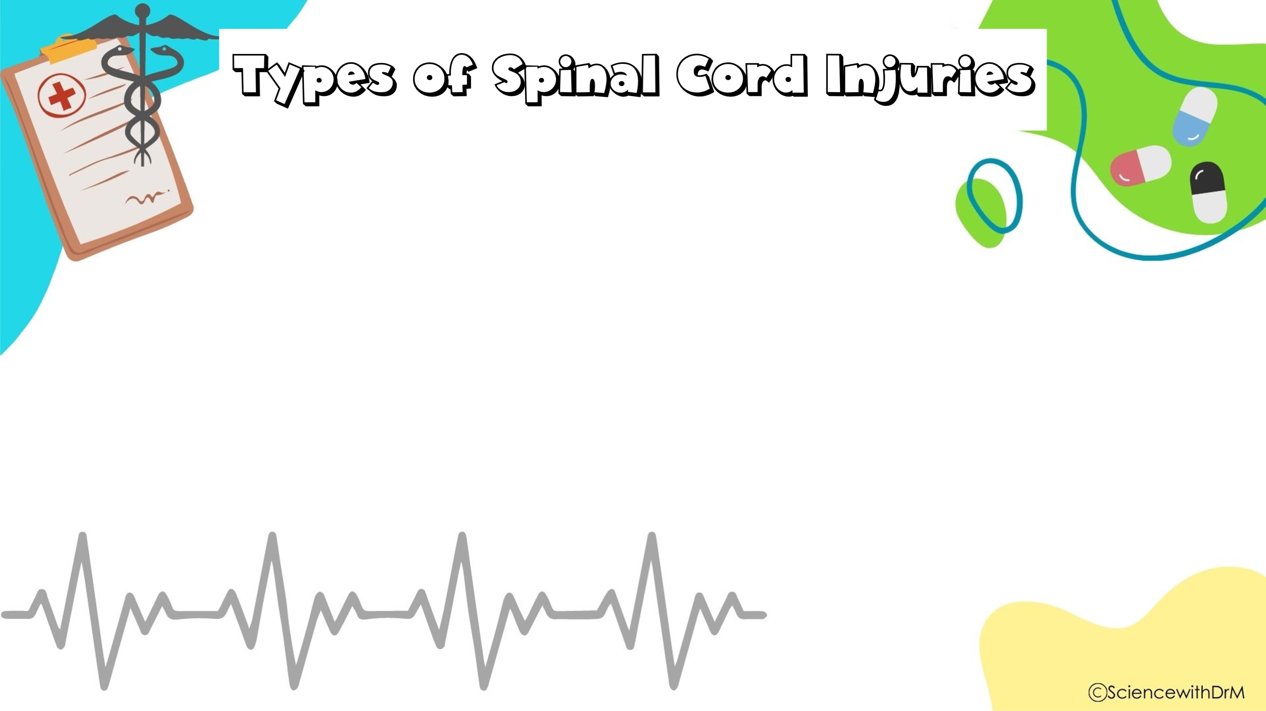
Type of Paralysis | Damage | Effect
Flaccid paralysis | Damage to anterior horn | Muscles atrophy
Spastic paralysis | Cut or crushed cord | Irregular nerve impulses
Paraplegia | Cut between T1- L1 | Lower limbs only
Quadriplegia | Damage in cervical region | All 4 limbs

Slide 23
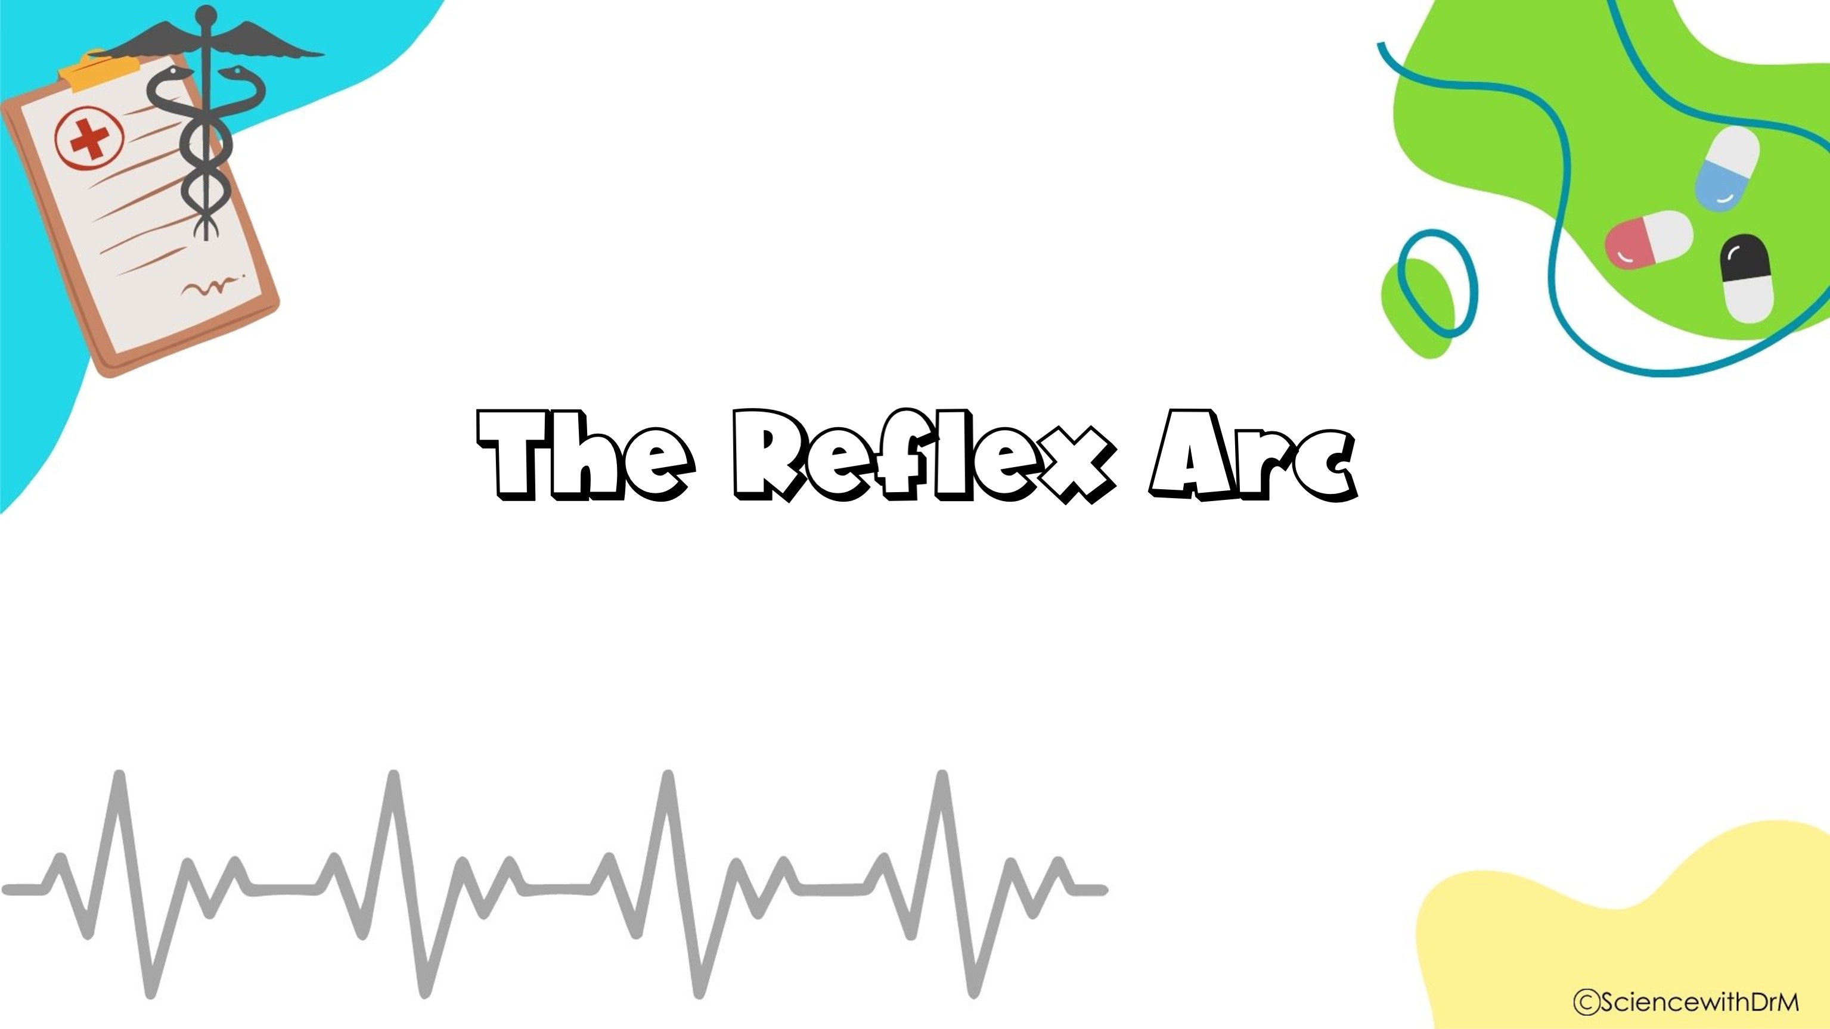
Quizlet Link: https://quizlet.com/816269013/the-reflex-arc-flash-cards/?i=lcu99&x=1jqt

Slide 24
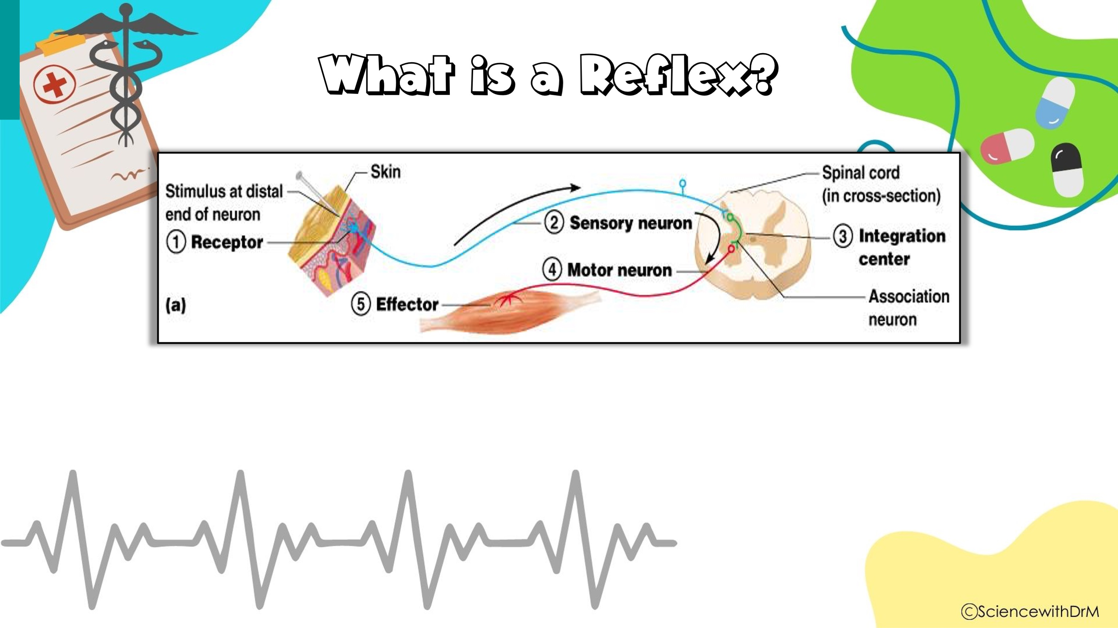
Reflex – rapid, predictable, and involuntary responses to stimuli
Reflex arc – direct route from a sensory neuron, to an interneuron, to an effector

Slide 25
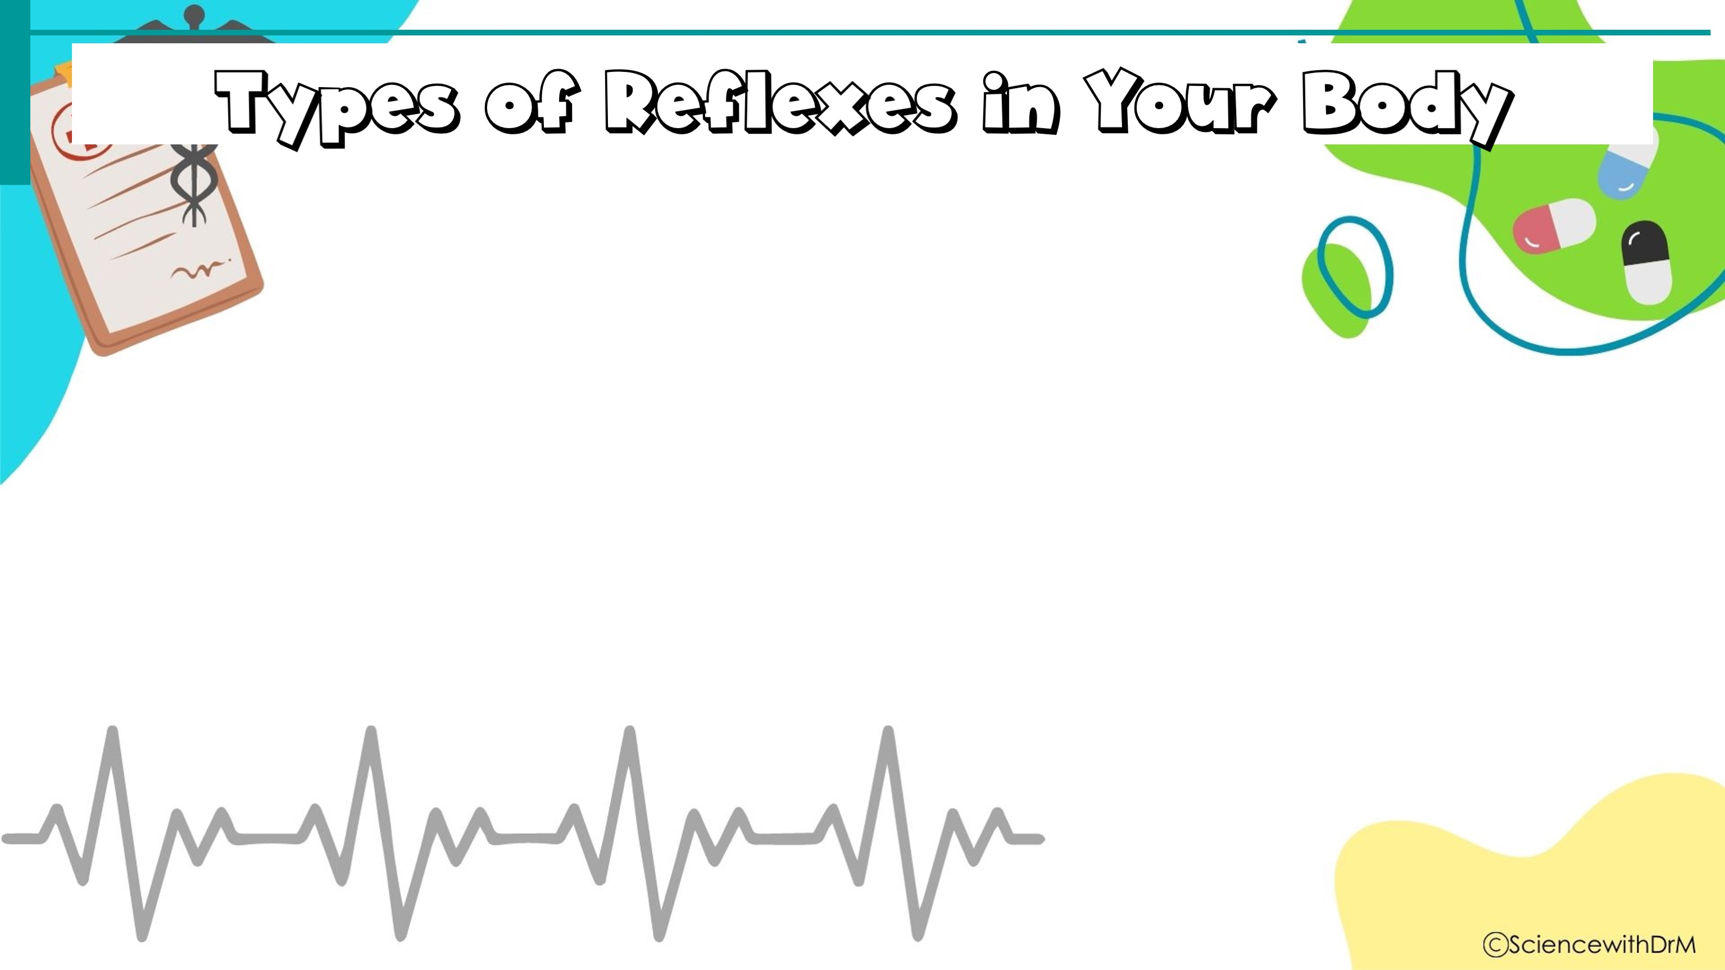
Autonomic Reflexes
Smooth muscle regulation
Heart and blood pressure regulation
Regulation of glands
Digestive system regulation
Somatic (Body) Reflexes
Activation of skeletal muscles

Slide 26
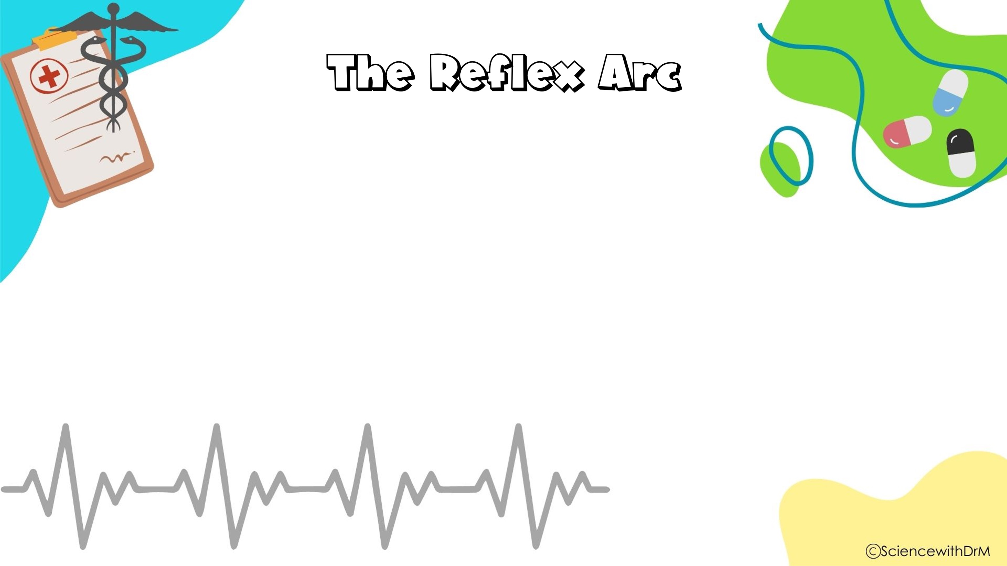
All reflex arcs have 4 elements:
1. Sensory receptor- reacts to stimulus
2. Afferent (sensory) neuron- goes to spinal cord
3. Efferent (motor) neuron- leaves spinal cord
4. Effector organ- muscle/gland that is stimulated

Slide 27
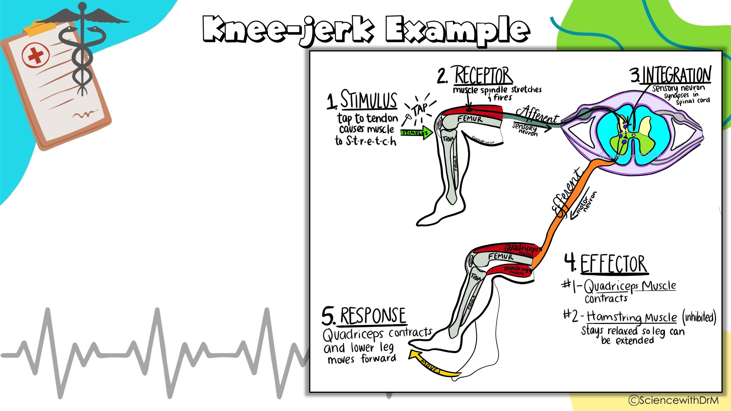
1. Stimulus- tap to tendon triggers stretch receptors
2. Sensory receptor- receptors in muscle stretched in knee.
3. Afferent (sensory) neuron/ integration- impulse travels from leg & synapses in spinal cord
4. Efferent (motor) neuron- impulse leaves spinal cord and travels to muscles of leg.
5. Effector organ/ response- muscle of leg moves

